Slide 1



Introducing Git and GitHub
Notes:
Adapted with <3 by Lindsey Berlin

Slide 2

Learning Objectives
(You Will Be Able To)
Fork a repository on GitHub
Clone a repository from GitHub
Add updates to track for a commit
Commit changes (with meaningful messages)
Push local changes to a remote repository
Pull remote changes to your local repository
Notes:
A note: students should be able to grab curriculum content and work on it locally after this lecture

Slide 3

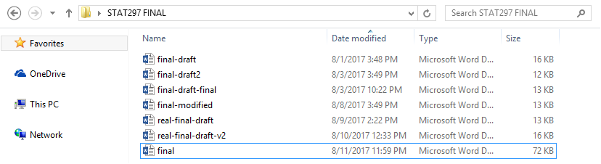
Look Familiar?
Notes:
Image Source: https://hackernoon.com/how-git-changed-the-history-of-software-version-control-5f2c0a0850df
Which one is the “final” version”? Do you go by name or date modified? Why does this need to be so hard??

Slide 4
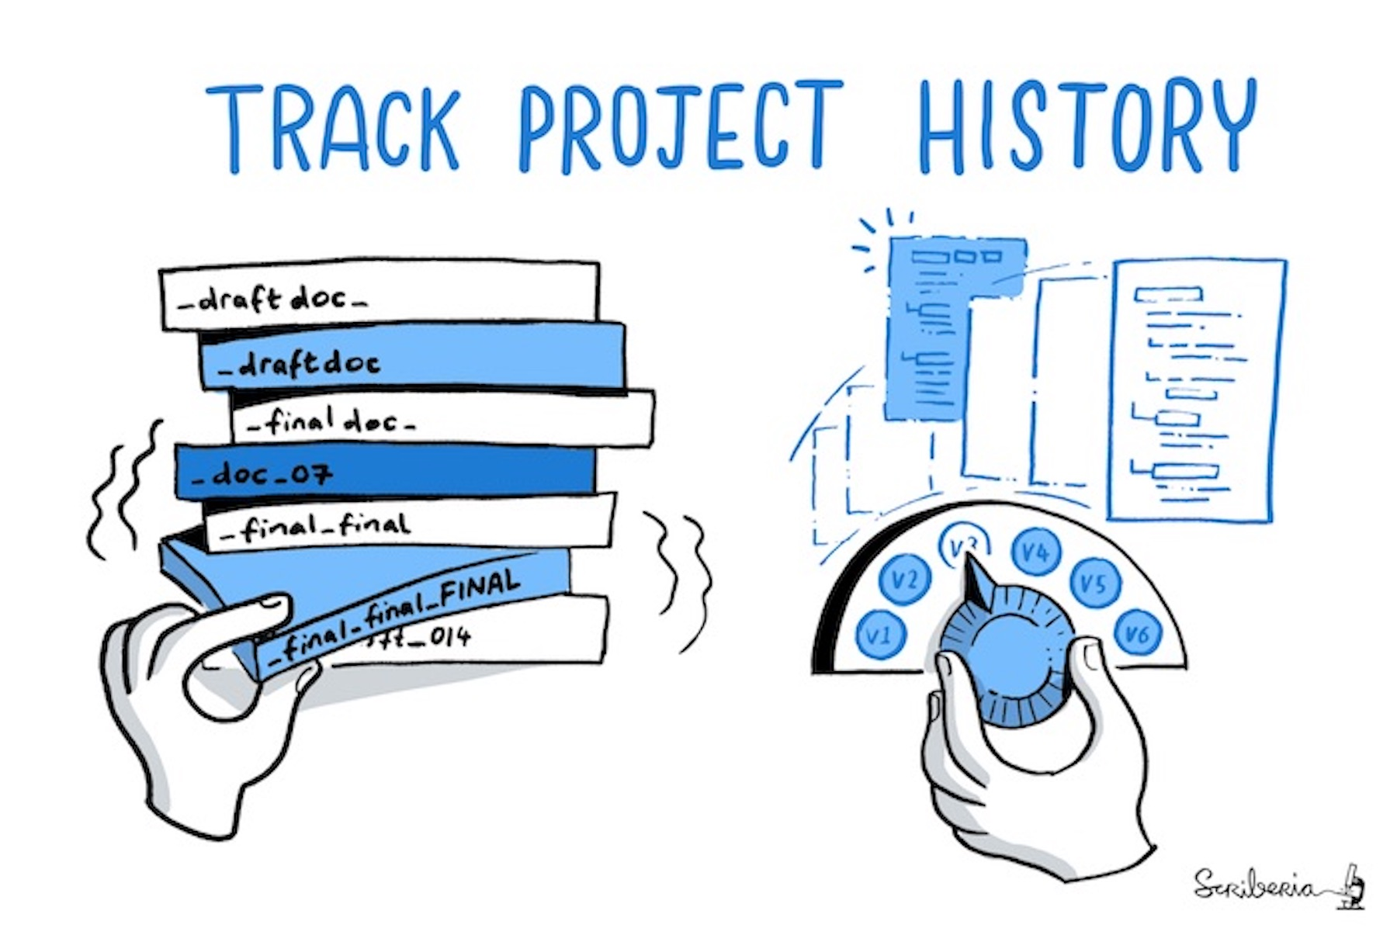
Enter: Version Control
Notes:
Image Source: https://the-turing-way.netlify.app/reproducible-research/vcs
Move away from naming new files, which is redundant and wastes space, to something lightweight that tracks versions and allows you to easily retrieve older versions of many files

Slide 5
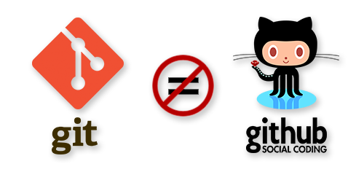
Important Distinction!
Notes:
Image Source (and additional resource to read about the distinction): https://guide.freecodecamp.org/git/difference-git-github/
Review from the DS Tools intro!
Git = local version control, a tool you can use to create and keep track of versions of your code so that you can reference or revert back to previous iterations. You can do all of your local version control on your own computer using Git, without ever connecting to the internet.
GitHub = host of Git repositories (their fancy word for a folder), so that you can share your code and collaborate. There are other git hosts, like GitLab

Slide 6

Let’s Do This Together
github.com/learn-co-curriculum/dsc-running-jupyter-locally-lab
Notes:
Can use this lab to demonstrate and practice a few of these skills - open this link, and we’ll follow some of the steps listed here, but then take it even further!

Slide 7

Fork a Repository
Forking creates your own personal copy over on your own personal GitHub.
On a fork, you can freely experiment with changes without affecting the original repository you copied from.
This is the best way to use someone else’s repository as a starting point for your own projects!
If you like, you can later submit those changes to the original repository in order to collaborate.
Notes:
Image Source: https://help.github.com/en/articles/fork-a-repo
Need more resources to learn about forking? Check out: https://help.github.com/en/github/getting-started-with-github/fork-a-repo
Forking workflow: https://www.atlassian.com/git/tutorials/comparing-workflows/forking-workflow

Slide 8
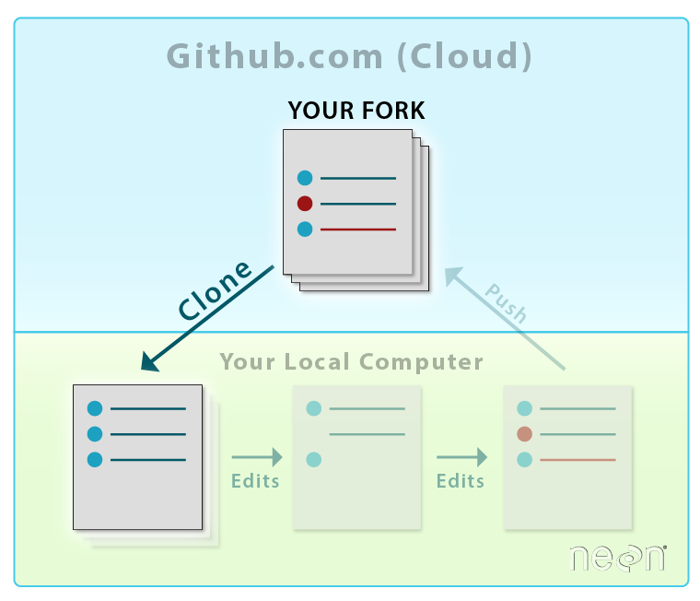
Clone a Repository
Cloning makes a copy of an existing online repository on your local machine.
git clone [URL]
The difference between forking and cloning is that cloning moves from cloud to local, as opposed to forking which moves code from someone else’s remote repository to your own remote repository - all in the cloud.
Notes:
Image source (and additional resource that has a series of git tutorials): https://www.neonscience.org/github-git-clone
Now, we move to the terminal!
Additional resource: https://help.github.com/en/articles/cloning-a-repository

Slide 9
Make Local Changes
This isn’t a git command - just make local changes to the jupyter notebook, or add a new file to the repository so we can see what it looks like to keep track of changes.

Slide 10
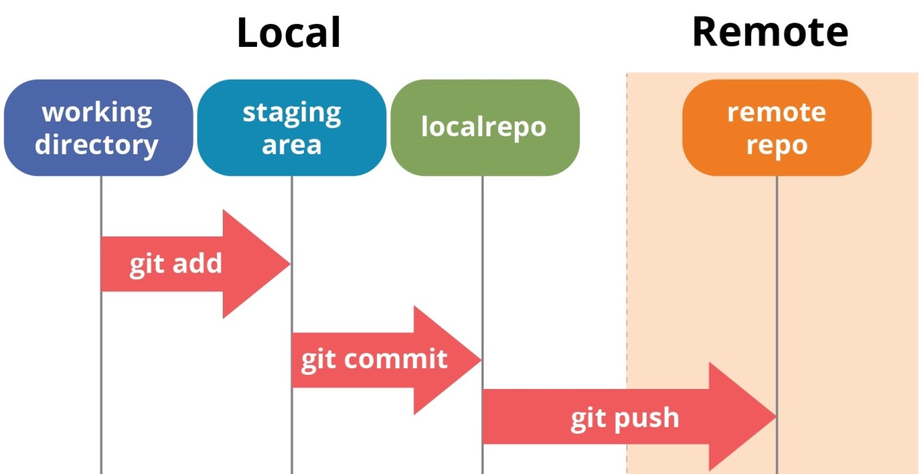
Check Your Status
what’s our status?
You made some changes, but what does that look like from Git’s point of view? In other words, where are we in the process, on our local drive?
git status
Git differentiates between staged and unstaged files (as well as tracked and untracked files).
Red represents unstaged files
Green represents staged files
Notes:
Original image source: https://www.quora.com/Where-can-I-learn-Git
Discuss how running git status will often tell you what the next step is!

Slide 11
There are more steps in Git than you think you need…
Notes:
Gif from Giphy
Yeah, it seems like some of the steps are redundant, and can feel like a lot - but it’s by design! Git wants to make it really hard for you to accidentally delete something, or to revert changes accidentally, or to save something you didn’t want to save, etc.

Slide 12
Add Your Changes
Adding files tells Git which changes you’d like to stage, to eventually be committed to your local repository.
git add [FILE]
Notes:
Original image source: https://www.quora.com/Where-can-I-learn-Git
Show how this changes the results of ‘git status’ in the terminal
If it comes up - yes, it’s possible to add all of your changes at once, or add and change in one fell swoop, but let’s get the basics down first one step at a time.

Slide 13
Commit Your Changes
Committing tells Git that these changes shouldn’t just be tracked, they’re actually ready to be a part of your local repository.
git commit -m “[MEANINGFUL MESSAGE]”
Commit messages should be written in the present tense, and should finish the sentence:
“If I apply these changes, they should…”
“Add spell check feature”
“Fix super awful bug written by David”
“Update gifs in README.md”
Notes:
Original image source: https://www.quora.com/Where-can-I-learn-Git
Show how this changes the results of ‘git status’ in the terminal
If it comes up - yes, it’s possible to add all of your changes at once, or add and change in one fell swoop, but let’s get the basics down first one step at a time.

Slide 14
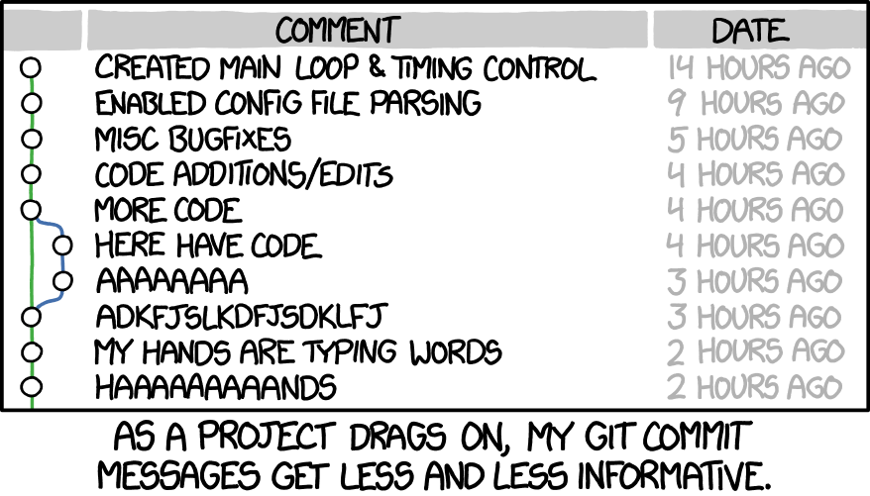
Don’t let this be you! Informative messages only!
Notes:
Image Source: https://xkcd.com/1296/

Slide 15
Push Your Changes
Pushing uploads your local repository to a remote repository (say, your GitHub)
git push [REMOTE LOCATION] [BRANCH]
(ex: git push origin main )
This is when you connect your local work to your remote repository - it also acts as you backing up your work to the cloud!
Notes:
Original image source: https://www.quora.com/Where-can-I-learn-Git

Slide 16
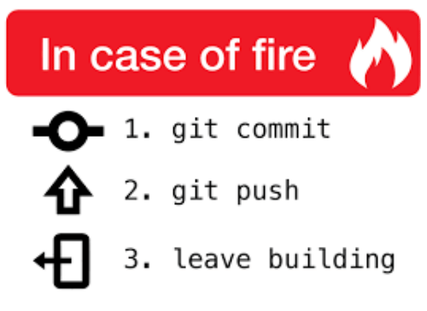
Programmer Protocol
Notes:
Image Source: https://chris.beams.io/posts/git-commit/
Pushing saves your work to the cloud, so even if you’re not using a remote to collaborate or share with others, it’s still useful to push your changes (GitHub or elsewhere)

Slide 17
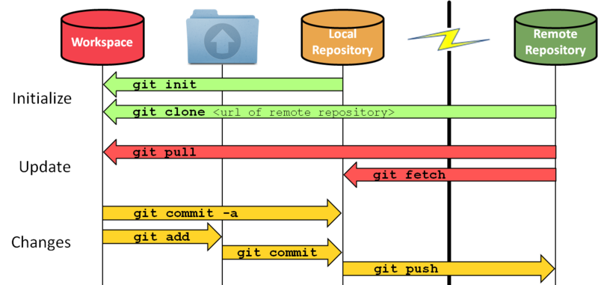
A Bigger Picture
Notes:
Original Image Source: https://skylabcoders.github.io/bootcamp-abril2017/img/git-schema-1.png

Slide 18
Pull Other Changes
Pulling brings remote changes down to your local workspace.
git pull [REMOTE LOCATION] [BRANCH]
If there are changes in the remote repository to which you’re trying to push changes, you’ll need to pull the changes down to your local machine before pushing your work back up.
Notes:
Original Image Source: https://skylabcoders.github.io/bootcamp-abril2017/img/git-schema-1.png
Basically, you need to make sure that, other than the changes you’ve made in your workspace, your local repo and the remote repo are the same. That way, you’re not potentially adding your changes that override someone else’s, etc.
‘Git pull’ does two things - merges and fetches. But if you’re not making changes to the same file (as we likely shouldn’t in this course), we can avoid the headaches of git merges and just use ‘git pull’

Slide 19
Progress So Far
What have we covered?
What haven’t we covered?
Starting from an existing repository
Forking workflow
Pushing changes
Creating your own repo from scratch
Branching workflow
Merging changes
Notes:
This is the first real slide of the Collaborating with Git lecture
Putting this into context
The git practice lab goes over creating a new repo both on GitHub and using git init
We’ll cover branches in the Git Collaboration lecture
We’ll discuss merge conflicts, and how to avoid them, in the git collaboration lecture as well

Slide 20
Additional Resources
This blog post is a nicely laid out walkthrough of git
Git has a whole open-source book on how to use git
Atlassian has their own version of GitHub, but their tutorial on Git is solid
Stumbled into a merge conflict? Learn how to resolve it in this blog post
Git and GitHub For Poets YouTube series

Slide 21

Any Questions?

